Slide 1
RadSense: Radio Sensing for Crime Monitoring in Restricted-Access Areas
Hung-Wen Liang, Shu-Ying Chang, Van-Linh Nguyen, Po-Ching Lin, and Ren-Hung Hwang
CITA 2024, July 19-20, 2024 - Da Nang City and Hoi An City, Viet Nam

Slide 2
Outline
Motivation
Problem Statement
Mathematical Formulation
Proposed Methods
Experiment Setup & Results Evaluation
Conclusion

Slide 3
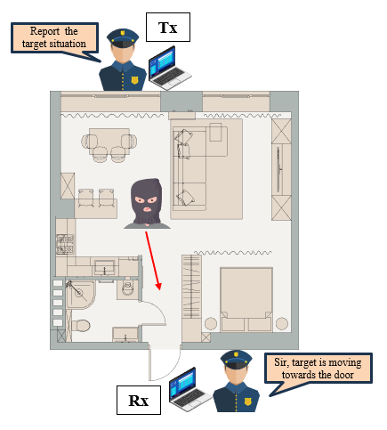
Motivation
Compared to outdoor sensing, indoor sensing technology is still immature.
Most of research in recent years focus on light-of-sight (LoS) scenarios.
Using passive sensing may encounter situations with weak signals.
Notes:
在室外，我們很常使用到GPS的技術來做定位、追蹤用途，是發展的很純熟的技術，但在室內環境卻還缺乏此類定位追蹤的技術，現代人的活動場所大多都在室內，也就更有可能會運用到此種功能。而近年因為無線網路的普及，也逐漸開發針對室內的追蹤和監測手段。
然而，我們所看到相關的研究探討，都還普遍使用light-of-sight 近距離的做動作辨認的測試，較缺乏利用更嚴苛的non-light-of-sight這樣的條件下實作。
我們這篇文章便設定在隔了牆壁後的目標動作偵測。
並且也使用主動式訊號發送來避免因為陌生環境中可能缺乏可靠且訊號不足夠的問題產生。

Slide 4
Literature Review (1/2)
Wireless sensing
Data Process
Model Structure Design
WiSDAR [7]
LPICRL [1]
Mixed
MCBAR [6]
Pi-Sniffer [5]
CATM-S [9]
DSTModel [8]
TTWDL[3]
MatNet-eCSI [12]
WiTL [4]
TARF [11]
Dense-LSTM [2]
Our work
CTTW [10]
Notes:
我們在文獻尋找中，發現無線訊號的偵測會分成兩種主流的增強方式，一種就是將資料處理的特徵越一致好抓越好。而另一種則是設計更複雜的模型，將資料簡單處理後，丟進模型讓模型自行將資料的特徵抓出來。
當然也有將兩種方式都應用其中，並加強效能，如 [12] 以及本篇研究。

Slide 5
Literature Review (2/2)
Study | Year | Solution | Data Input | Learning model | Simple processing | Cross-domain | Through the wall | Direction classification
CATM-S[9] | 2023 | Data process-based | CATM | CNN + LSTM | ✗ | ✗ | ✗ | ✗
Pi-Sniffer[5] | 2023 | Data process-based | Amplitude | LSTM | ✓ | ✗ | ✓ | ✓
TARF[11] | 2023 | Data process-based | DFS | CNN | ✓ | ✗ | ✓ | ✗
TTWDL[3] | 2024 | Data process-based | Amplitude | LSTM | ✗ | ✓ | ✓ | ✗
MatNet-eCSI[12] | 2022 | Mixed | CFM | CNN+LSTM+FSL | ✗ | ✓ | ✗ | ✗
Ours | 2024 | Mixed | Amplitude+phase | CNN + TripletNetwork + FSL | ✓ | ✓ | ✓ | ✓
Few-shot learning
Notes:
而資料的處理，會著重於如何將其目標的特點放大或者使其更清晰好辨認 CTTW 使用一種EMD 演算法，根據自身時間尺度將信號分解分析，能使複雜信號分解為有限個本徵模函數，在處理不太平穩的信號來說是非常有用。能有很高信造比(SNR)
CATM-S 將資料的AOA 和TOF 提出來一起運用，在不同角度放置接收器，以不同角度收到的樣態來辨別動作。
Pi-Sniffer 使用小波轉換，將訊號變化的起始跟結束點抓出，來判定動作類型，同時也利用多個能接收訊號的設備強化其判定方向的可能性
TTWDL 在資料處理時，使用了4-5個步驟逐步將outlier ，訊號pattern抓取出來，才放入其模型中學習。
以上的文獻有些步驟太繁瑣，若比較缺乏時間做對應處理的話，結果可預期的都可能不會太好。 而我們的實驗，使用了一個CNN基底的近似度學習模型，教導模型只是學習不同的類別如何區分，並在變化環境時，無需太多資料。
我們這邊還有一點就是，我們將walking不同方向當作不同動作來辨別。

Slide 6
Problem Statement
Input: Channel state information (CSI) with amplitude and phase details from the signal.
Output: The NLoS target movement classifications.
Goal:
Detect the movement behind restricted NLoS areas.
Identify four types of the target movement.
Challenges:
The signal quality will degrade due to multipath effects and the wall penetration.
Hardware imperfection between the transmitter and receiver asynchronous produce signal offsets reduce the precision.
Signal reflection and refraction by static and dynamic components, and separate them to identify the target movement.
Notes:
信號在室內受到多路徑的影響會互相干擾，或者信號能量減弱，並且穿過牆也會有部分信號被反彈，造成擷取到的信號特徵不明確。
我們硬體分開且沒有做時脈同步，在收訊時，會有時間延遲和相位偏移 另外，在室內偵測目標時，訊號都是因為靜態如櫃子、牆壁等反射占大部分，若想更準確判斷動作則要試著將移動反射的訊號擷取出來運用。

Slide 7
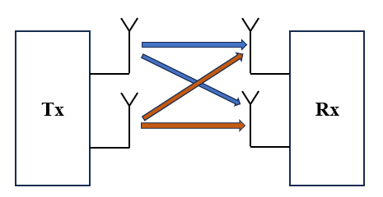
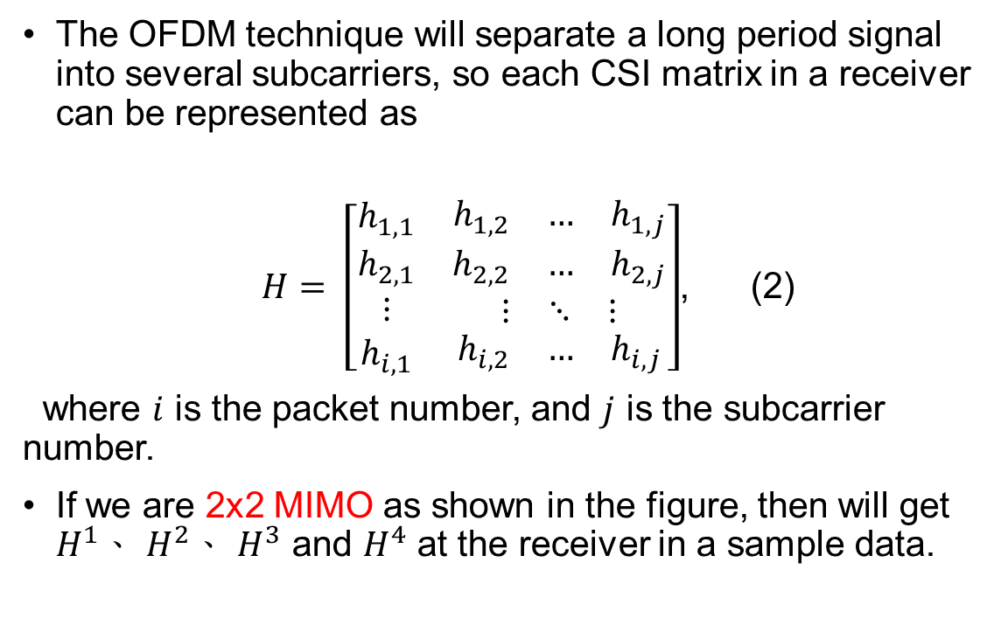
CSI Under OFDM-MIMO
The OFDM technique will separate a long period signal into several subcarriers, so each CSI matrix in a receiver can be represented as
$H= \left[\begin{matrix}\begin{matrix}h_{1,1} \\ h_{2,1} \\ ⋮\end{matrix} & \begin{matrix}\begin{matrix}h_{1,2} & … & h_{1,j}\end{matrix} \\ \begin{matrix}h_{2,2} & … & h_{2,j}\end{matrix} \\ \begin{matrix}⋮ & ⋱ & ⋮\end{matrix}\end{matrix} \\ h_{i,1} & \begin{matrix}h_{i,2} & … & h_{i,j}\end{matrix}\end{matrix}\right]$, (2)
where $i$ is the packet number, and $j$ is the subcarrier number.
If we are 2x2 MIMO as shown in the figure, then will get $H^{1}$、 $H^{2}$、 $H^{3}$ and $H^{4}$ at the receiver in a sample data.
1
2
3
4
Notes:
而在我們日常使用的訊號發送技術OFDM下，會將長時間的訊號分到多個訊號載波上做傳送，能提高訊號發送速度和降低頻率的衰減。而我們所收到的CSI格式因應子載波的切分，也能改寫成以上這個矩陣，每個CSI會有多格封包，而每個封包又分別會有數個子載波傳送資料。
因此在一個接收端Rx 天線都能收到此CSI 矩陣，若是MIMO 2*2 設備則就會有 多個CSI 矩陣H

Slide 8
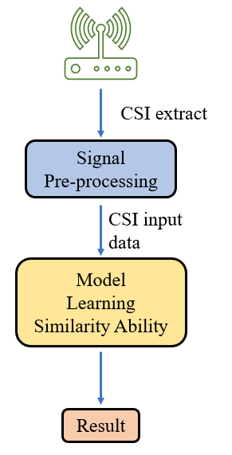
Proposed Method (1/2)
Key idea:
Using several simple pre-processing steps to improve our data distinguishable.
Applying the phase calibrate that make us can distinguish the walking movement but has different direction and also improve the accuracy.
Using the CNN-based TripletNetwork to train our model learn how to identify the difference between two samples not just fit the specify dataset.
Notes:
我的提出的關鍵想法是，我們能將相位校正利用在動作辨識上，原本相位的資訊多用於定位和路徑追蹤等有方向性的任務上，若能在動作辨識中使用，進而能幫助我們在同類型動作能判斷其移動方向。 另外我們使用的是一個學習分辨相似度模型，不單純去針對資料集擬和。進而在未見過的資料上不用做複雜的調整，可快速區分差異性。
根據我們所知，是首先運用共惡乘法在動作分辨上做處理。進而提升準確度並能輔助方向判斷。
我們針對天現做校正。
我們提出相似度少樣本學習模型，並利用特殊訓練手法，讓我們轉換環境時也能使用少量資料有效判別類別。

Slide 9
Proposed Method (2/2)
Our contributions:
To the best of our knowledge, this work is the first to utilize conjugate multiplication in activity recognition to calibrate phase error leads us able to identify the direction.
This work first correct antenna random jump situations of the Intel AX200/210 series.
We proposed a CNN-based TripletNetwork plus few-shot learning method and special training procedure to distinguish the difference between samples and only with few support samples can get a efficient result across the different environments.
Notes:
我的提出的關鍵想法是，我們能將相位校正利用在動作辨識上，原本相位的資訊多用於定位和路徑追蹤等有方向性的任務上，若能在動作辨識中使用，進而能幫助我們在同類型動作能判斷其移動方向。 另外我們使用的是一個學習分辨相似度模型，不單純去針對資料集擬和。進而在未見過的資料上不用做複雜的調整，可快速區分差異性。
根據我們所知，是首先運用共惡乘法在動作分辨上做處理。進而提升準確度並能輔助方向判斷。
我們針對天現做校正。
我們提出相似度少樣本學習模型，並利用特殊訓練手法，讓我們轉換環境時也能使用少量資料有效判別類別。

Slide 10
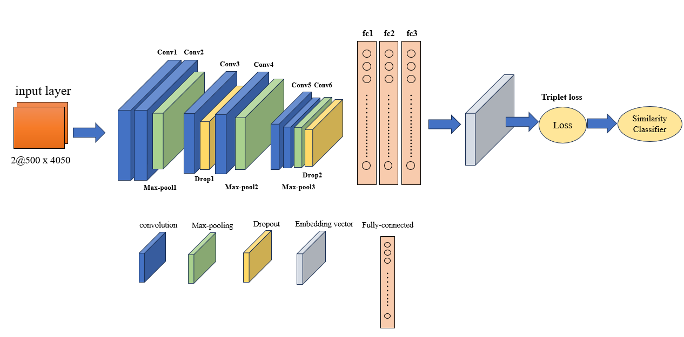
Our Model Design
2 channels: amplitude & phase
500:packets number
4050: subcarriers number
Our model applies a CNN-based TripletNet and use few-shot learning predict the unseen data.
The CNN will be the main feature extractor and train the model to classify similarity using triplet loss.
We refer to MatNet-eCSI [12] training process to create a three-steps training process.
Our model layer design
Reference [12]: Z. Shi, J. A. Zhang, R. Y. Xu and Q. Cheng, "Environment-Robust Device-Free Human Activity Recognition With Channel-State-Information Enhancement and One-Shot Learning," in IEEE Transactions on Mobile Computing, vol. 21, no. 2, pp. 540-554, 1 Feb. 2022, doi: 10.1109/TMC.2020.3012433
Notes:
CNN的架構如圖所示，總共有六層，並通過兩層drop out丟棄一些數值，增加其訓練效益避免過擬合
在訓練的手法上，我們參考了MatNet 的方法，但是其只運用了兩步驟，我們多加了一個步驟加速我們模型的收斂速度，並且後續訓練模式更適合我的tripletNetwork。

Slide 11
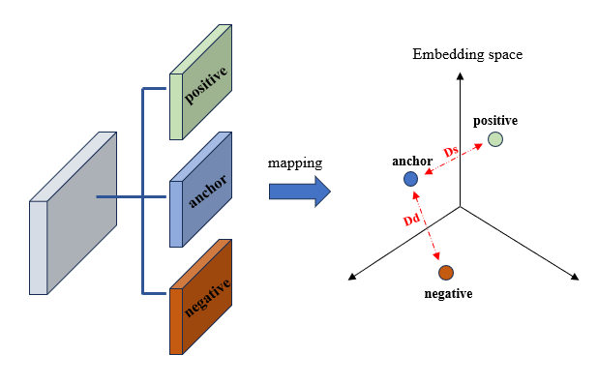
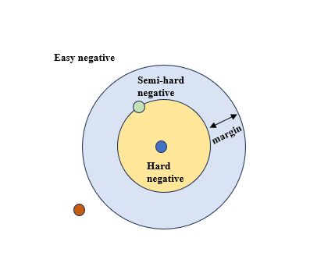
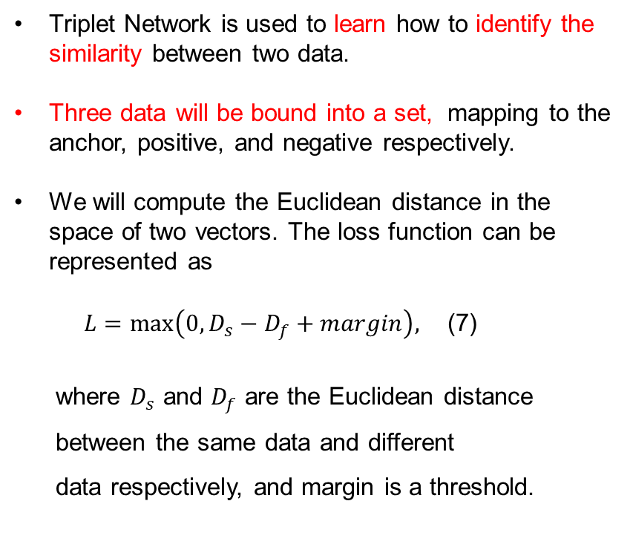
Triplet Network
Triplet Network is used to learn how to identify the similarity between two data.
Three data will be bound into a set, mapping to the anchor, positive, and negative respectively.
We will compute the Euclidean distance in the space of two vectors. The loss function can be represented as
$L=\max\left(0,D_{s}−D_{f}+margin\right),$ (7)
where $D_{s}$ and $D_{f}$ are the Euclidean distance
between the same data and different
data respectively, and margin is a threshold.
Notes:
TripletNetwork 在訓練時，會將三個資料包成一組輸入，分別為茅點，和毛點相似的正樣本，以及相反的負樣本。通過網路層後會映射到另一空間成為一嵌入向量，在這空間內我們會將兩點倆倆算歐式距離來區別差異性。並藉由loss的更新，訓練模型能將相似的拉近並將不相似的推遠，達到相似度分析能力
我們的損失函數如上攻勢，其中margin為一閥值，也是會影響相似性判斷難易程度。若是此margin值越小，則越容易將值判定為不相似，儘管訓練時準確度會很高，但未看過的資料上則會出現較大的誤差

Slide 12
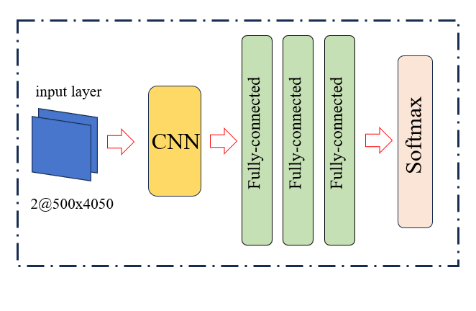
Three-steps Training Method Progress (1/3)
Step1: We use regular CNN model to train, reserving the feature extractor for use in the next step.
Through this step, we can speed up our model convergence.
Feature
Extractor
Notes:
步驟一主要是經由訓練CNN的特徵提取並保留其銓重蹈後面訓練使用

Slide 13
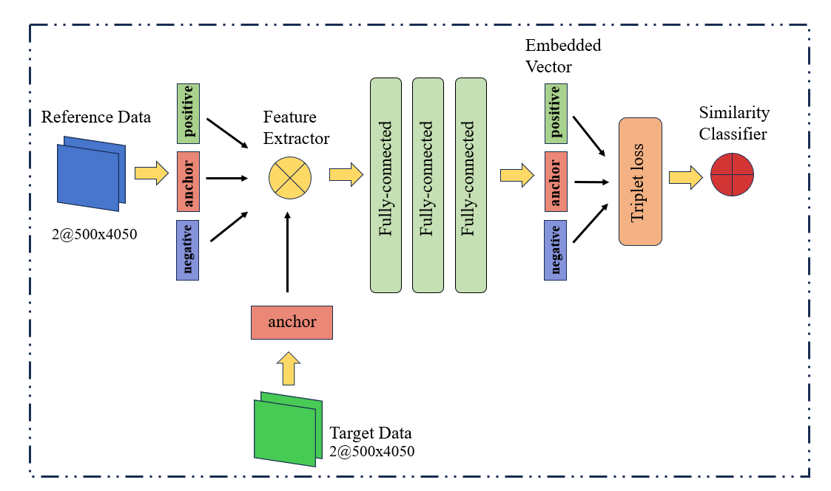
Three-steps Training Method Progress (2/3)
Step2: In this step, we intend to train the similarity classifier with two different datasets.
Target data will come from a new testing environment and just use a little data as the anchor.
This step is to build the connection between different environments.
Notes:
第二步驟主要會是以建立兩個不同環境的資料集間的連結，使的之後在預測testing 環境時能更好辨別。訓練環境和測試環境都會拿出資料當anchor，各個類型動作各拿20個，而positive and negative則都是從訓練資料出來的。以隨機選取的方式組合三元祖組合並丟進去模型做相似度學習，

Slide 14
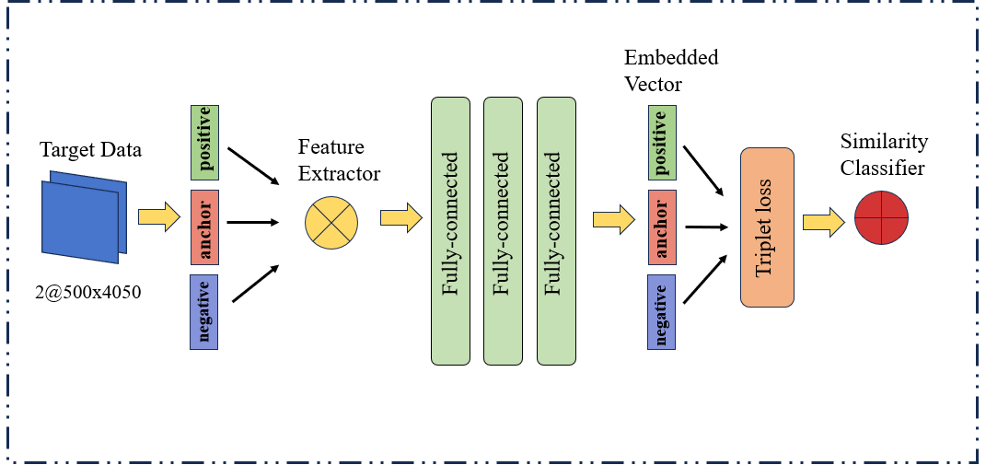
Three-steps Training Method Progress (3/3)
Step3: We would utilize the same structure as step2 and only use the dataset from the testing environment.
We use a little data to fine-tune the classifier so that it could improve the testing accuracy.
Notes:
第三步驟算是一個微調的過程，我們也只拿取集少量資料做微調，每種類型5個當anchor ，15個當positive and negative

Slide 15
Testing Stage
The rest data of testing environment will be our support set and query set to calculate accuracy.
We test with 1-shot、5-shot、7-shot and 10-shot.
The prediction will be the most similar data of query and each type of support set.
Notes:
幾shot就是support set中的每個類型有幾個參考資料，此資料在前面都未曾被使用過。
每個類別有多個檔案，我們會各自跟query算出一個歐式距離，然後同類別的算一個平均值。 最後看query跟哪一個類別的平均值距離最小，則為我們的預測類型。

Slide 16
Experiment Setting Environment (1/5)
We have three scenarios: environment A, environment B, environment C, environment D.
The four scenarios have different arrangements and walking path distances.
We collected four types of activities include empty, stand, moving away, and moving close.

Slide 17
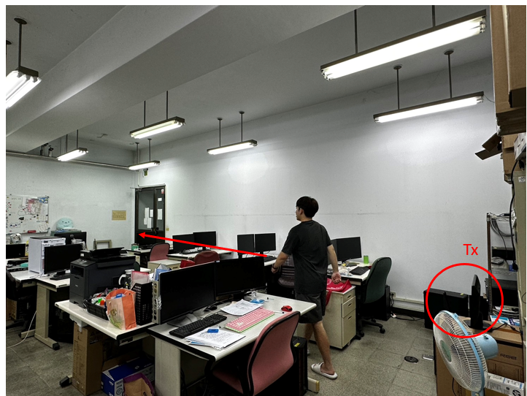
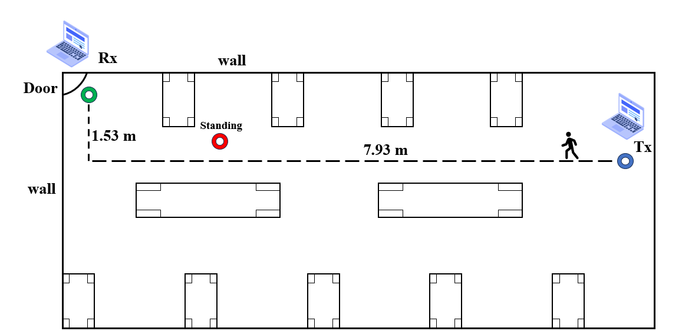
Experiment Setting Environment (2/5)
Environment A: Lab401

Slide 18
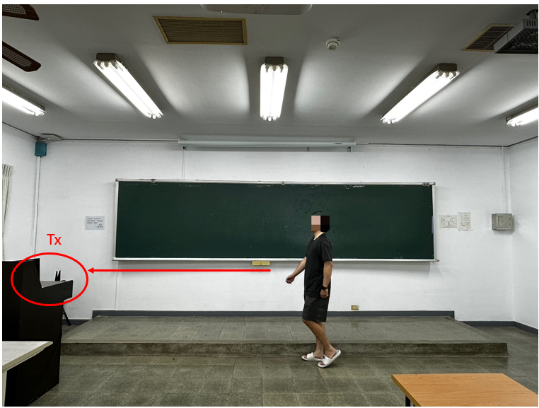
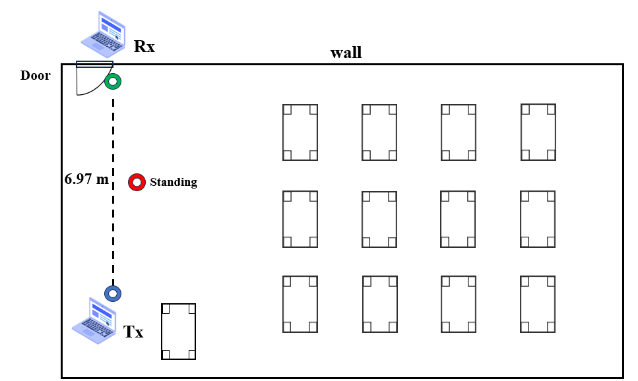
Experiment Setting Environment (3/5)
Environment B: Classroom204

Slide 19
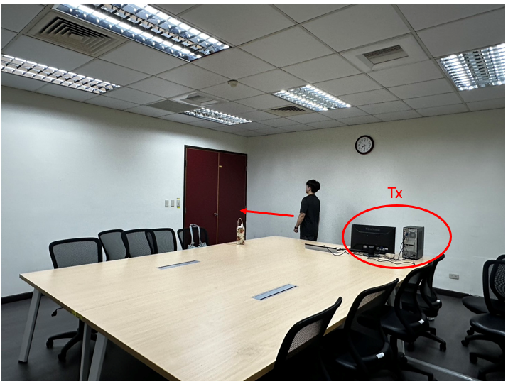
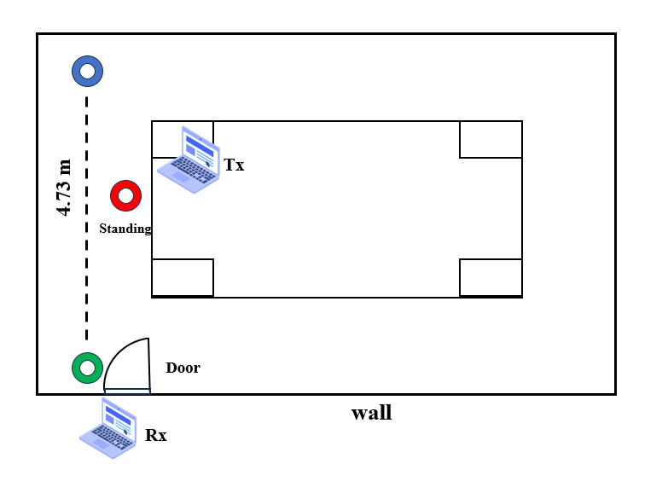
Experiment Setting Environment (4/5)
Environment C: Classroom203

Slide 20
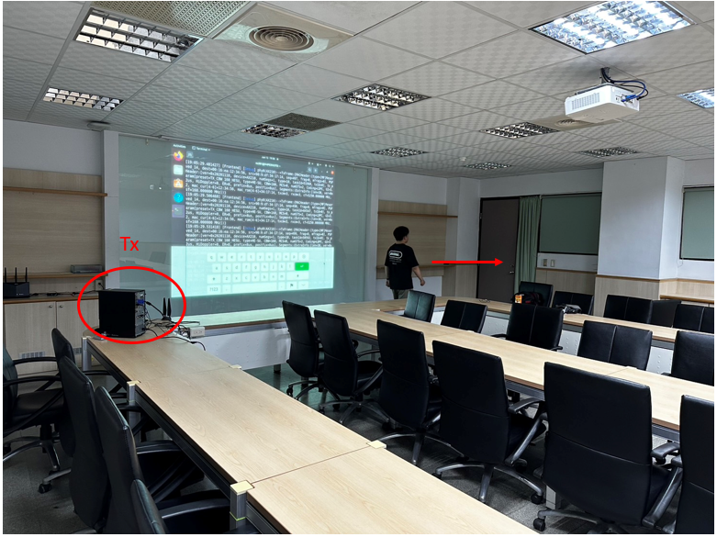
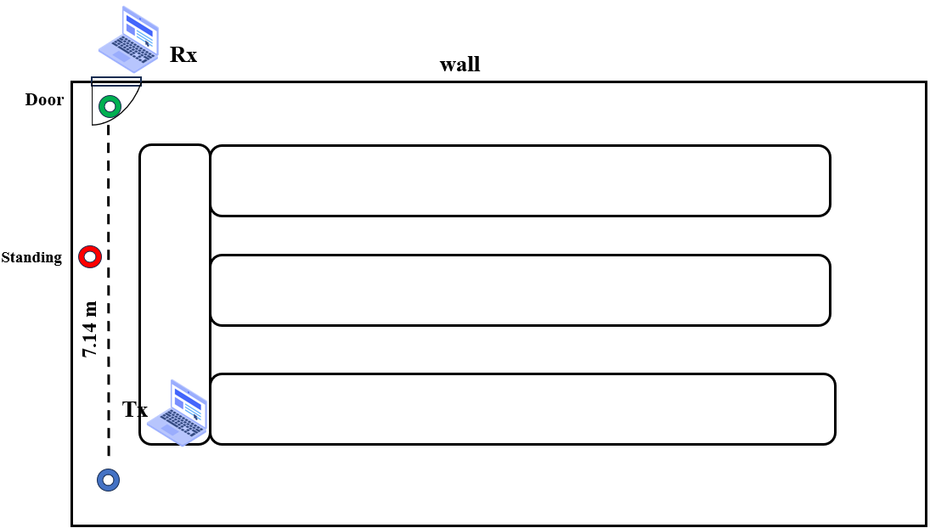
Experiment Setting Environment (5/5)
Environment D : Classroom 105

Slide 21
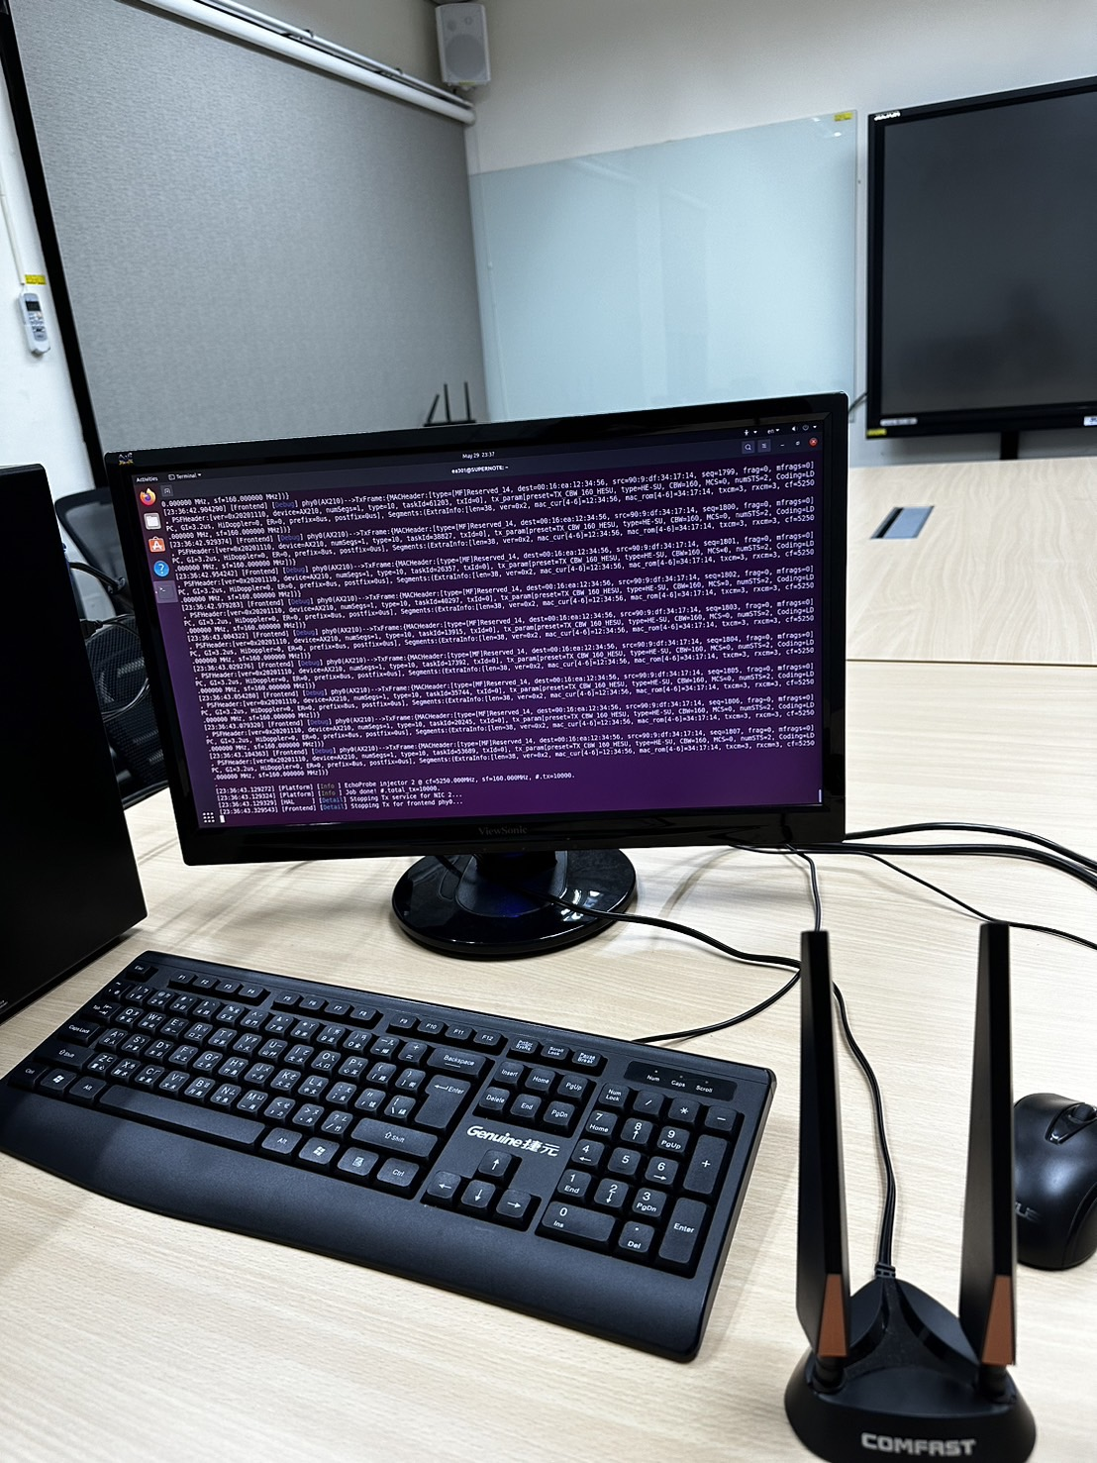
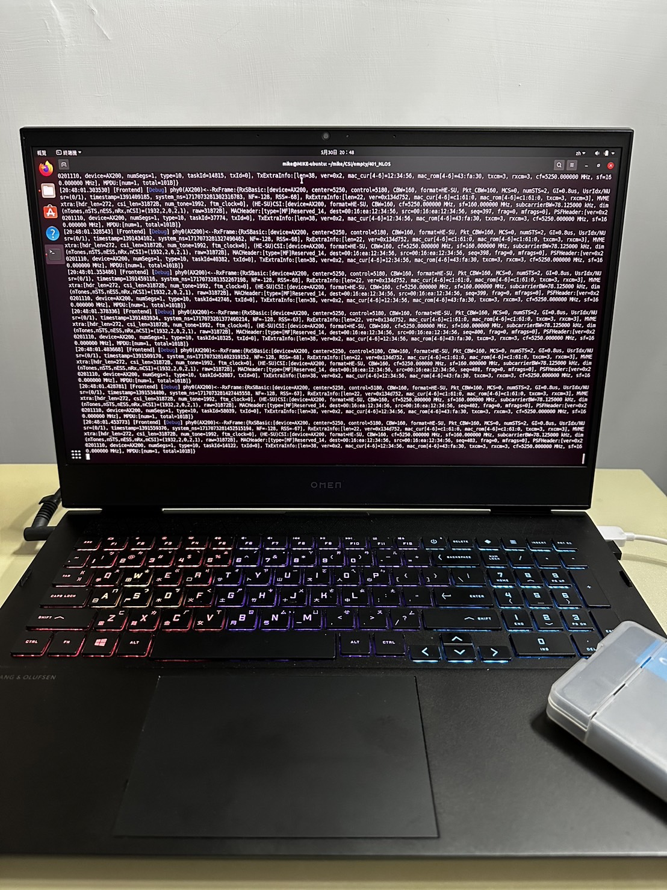
Experiment Setting Equipment
Two computers with Intel AX200/210 series NICs, which have two antennas, are the transmitter and receiver respectively in this work.
We utilize a 5.25 GHz frequency and 160 MHz bandwidth, which can collect 2025 subcarriers in a packet.
Each time we transmit 500 packets for one sample.
We apply a 40 Hz sampling rate, so every sample is 12.5 seconds.
Transmitter
Receiver
Notes:
我們用的是2X2 MIMO如前面提到的，

Slide 22
Evaluation Different Model of Cross-environment Performance (1/2)
56.74
Notes:
我們分別用四個環境收集到的資料訓練一般的CNN模型和CNN-based TripletNetwork學習模型， CNN的layer設置如同我們前面的架構設置，並且將訓練好的模型去測試一樣不同環境的資料集預測效果，跟其對比的是使用TripletNetwork學習模型後，在不同測試環境中拿出數筆資料當support set來判斷的效果。可以看到，在未知的測試環境中，若是CNN沒能先使用資料集去擬何模型的話，他的預測準確度會明顯很差。

Slide 23
Evaluation Different Model of Cross-environment Performance (2/2)
The two walking patterns lead the data hard to classify
Notes:
環境D的資料集在這兩種模型中表現的不太好，我們認為是其中的兩種資料特徵類型，在walking那邊我們想區分方向，但特徵還不好提取而導致模型無法好好辨識，而在後面我們將資料做相位處理後有提升了環境D的特徵辨識，使其可以有效學習。

Slide 24
Evaluation The Effect of Applying Three-steps Training Method (1/2)
Under four-ways-few-shots testing, the accuracy is about 50% to 80%.
Dataset: 180 sample points for each activity
20.8

Slide 25
Evaluation The Effect of Applying Three-steps Training Method (2/2)
After applying our three-steps training method, the overall accuracy can improve 6-21%.
6.88
12.12
21.79

Slide 26
Evaluation Comprehensive Analysis
Train in Environment: A
Test in Environment: A、C、D
Environment A | Empty | Moving away | Stand | Moving close | Overall
1-shot | 100% | 0% | 0% | 0% | 25%
5-shot | 100% | 0% | 0% | 0% | 25%
7-shot | 100% | 0% | 0% | 0% | 25%
10-shot | 100% | 0% | 0% | 0% | 25%
Environment C | Empty | Moving away | Stand | Moving close | Overall
1-shot | 52.31% | 98.46% | 81.54% | 84.62% | 79.23%
5-shot | 77.69% | 97.69% | 76.15% | 84.62% | 84.04%
7-shot | 73.85% | 96.92% | 76.92% | 85.38% | 83.27%
10-shot | 67.69% | 97.69% | 77.69% | 86.92% | 82.50%
Environment D | Empty | Moving away | Stand | Moving close | Overall
1-shot | 98.46% | 73.08% | 80.77% | 72.31% | 81.15%
5-shot | 95.38% | 60.77% | 86.15% | 66.92% | 77.31%
7-shot | 95.38% | 60.00% | 90.00% | 66.15% | 77.88%
10-shot | 95.38% | 64.62% | 89.23% | 66.92% | 79.04%
Notes:
環境B的D資料看起來只有empty 、stand準確度較高，我們認為是因為path的長度接近，讓信號彈射的變化可能也較相似

Slide 27
Evaluation Comprehensive Analysis
Train in Environment: B
Test in Environment: A、B、D
Environment A | Empty | Moving away | Stand | Moving close | Overall
1-shot | 100% | 0% | 0% | 0% | 25%
5-shot | 100% | 0% | 0% | 0% | 25%
7-shot | 100% | 0% | 0% | 0% | 25%
10-shot | 100% | 0% | 0% | 0% | 25%
Environment B | Empty | Moving away | Stand | Moving close | Overall
1-shot | 84.62% | 100% | 95.38% | 19.23% | 74.81%
5-shot | 97.69% | 97.69% | 96.92% | 52.31% | 86.15%
7-shot | 97.69% | 96.92% | 96.92% | 56.15% | 86.92%
10-shot | 97.69% | 97.69% | 96.92% | 52.30% | 86.15%
Environment D | Empty | Moving away | Stand | Moving close | Overall
1-shot | 88.46% | 89.23% | 76.15% | 72.31% | 81.54%
5-shot | 90.77% | 83.85% | 83.08% | 67.69% | 81.35%
7-shot | 92.31% | 82.31% | 82.31% | 70.00% | 81.73%
10-shot | 92.31% | 86.92% | 79.23% | 73.08% | 82.88%
Notes:
在環境C訓練的資料，其靠近的區分能力是四類中最差的，

Slide 28
Evaluation Comprehensive Analysis
Train in Environment: C
Test in Environment: A、B、C
Environment A | Empty | Moving away | Stand | Moving close | Overall
1-shot | 100% | 0% | 0% | 0% | 25%
5-shot | 100% | 0% | 0% | 0% | 25%
7-shot | 100% | 0% | 0% | 0% | 25%
10-shot | 100% | 0% | 0% | 0% | 25%
Back to normal level
Environment B | Empty | Moving away | Stand | Moving close | Overall
1-shot | 75.38% | 81.54% | 74.62% | 60.77% | 73.08%
5-shot | 95.38% | 73.08% | 89.23% | 72.31% | 82.50%
7-shot | 94.62% | 75.38% | 89.23% | 65.38% | 81.15%
10-shot | 95.38% | 74.62% | 93.08% | 71.54% | 83.65%
Environment C | Empty | Moving away | Stand | Moving close | Overall
1-shot | 63.85% | 83.08% | 71.54% | 98.46% | 79.23%
5-shot | 80.77% | 97.69% | 70.77% | 99.23% | 87.12%
7-shot | 71.54% | 95.38% | 70.77% | 100% | 84.42%
10-shot | 69.23% | 98.46% | 71.54% | 99.23% | 84.62%
Notes:
環境D在經過相位消除和HPF處理後，overall的效能都提升到於其他環境相近。

Slide 29
Conclusion
We utilize antenna random jump, phase calibration, and dynamic extraction preprocessing procedure to improve the data consistency. However, in some complicated environments we have to figure out other method.
We apply a novel CNN-based TripletNetwork plus few-shot learning method to identify samples across the different environments.
Our proposed method can reach the best overall accuracy about 86.15%.
Notes:
經過我們的幾種資料前處理後，有提升了對於資料的辨認。 但是，我們發現在雜物太多的情況下此類項位的直接消除還不太適用，我們要再使用其他方式將此複雜的資料先做一次清潔之類的方式。
我們的模型讓我們能在不同的環境當中做判別，而且這邊我們用到的資料量的不多。
我們這樣的少樣本學習後，最佳的整體表現能達到86.15%

Slide 30
Publications
Shu-Ying Chang, Hung-Wen Liang, Van-Linh , Po-Ching Lin , “Seeing Without Alarming Thief: Passive WiFi Sensing for Indoor Security Monitoring”, MILCOM 2023 - 2023 IEEE Military Communications Conference (MILCOM) - DEMOS

Slide 31
Reference
Ma, Y., Arshad, S., Muniraju, S., Torkildson, E., Rantala, E., Doppler, K., Zhou, G., 2021. Location- and Person-Independent Activity Recognition with WiFi, Deep Neural Networks, and Reinforcement Learning. ACM Transactions on Internet of Things 2, 1–25.. https://doi.org/10.1145/3424739
Zhang, J., Wu, F., Wei, B., Zhang, Q., Huang, H., Shah, S.W., Cheng, J., 2021. Data Augmentation and Dense-LSTM for Human Activity Recognition Using WiFi Signal. IEEE Internet of Things Journal 8, 4628–4641.. https://doi.org/10.1109/jiot.2020.3026732
Abuhoureyah, F. S., Wong, Y. C., & Mohd Isira, A. S. B. (2024). WiFi-based human activity recognition through wall using deep learning. Engineering Applications of Artificial Intelligence, 127, 107171. https://doi.org/https://doi.org/10.1016/j.engappai.2023.107171
Chi Lin, Pengfei Wang, Chuanying Ji, Mohammad S. Obaidat, Lei Wang, Guowei Wu, and Qiang Zhang. 2023. A Contactless Authentication System Based on WiFi CSI. ACM Trans. Sen. Netw. 19, 2, Article 29 (May 2023), 20 pages. https://doi.org/10.1145/3532095
Shun, Z., Hou, J., Li, X.-Y., 2023. Pi-Sniffer: Privacy Sniffing through the Wall with WiFi CSI, in: https://doi.org/10.1109/bigcom61073.2023.00018
D. Wang, J. Yang, W. Cui, L. Xie and S. Sun, "Multimodal CSI-Based Human Activity Recognition Using GANs," in IEEE Internet of Things Journal, vol. 8, no. 24, pp. 17345-17355, 15 Dec.15, 2021, doi: 10.1109/JIOT.2021.3080401
F. Wang, W. Gong and J. Liu, "On Spatial Diversity in WiFi-Based Human Activity Recognition: A Deep Learning-Based Approach," in IEEE Internet of Things Journal, vol. 6, no. 2, pp. 2035-2047, April 2019, doi: 10.1109/JIOT.2018.2871445

Slide 32
Reference
B. Sheng, F. Xiao, L. Sha and L. Sun, "Deep Spatial–Temporal Model Based Cross-Scene Action Recognition Using Commodity WiFi," in IEEE Internet of Things Journal, vol. 7, no. 4, pp. 3592-3601, April 2020, doi: 10.1109/JIOT.2020.2973272
Y. Ge et al., "WiFi sensing of Human Activity Recognition using Continuous AoA-ToF Maps," 2023 IEEE Wireless Communications and Networking Conference (WCNC), Glasgow, United Kingdom, 2023, pp. 1-6, doi: 10.1109/WCNC55385.2023.10118954.
R. Cao, X. Yang, Z. Yang, M. Zhou and L. Xie, "Research on Human Activity Recognition Technology under the Condition of Through-the-wall," 2020 IEEE/CIC International Conference on Communications in China (ICCC), Chongqing, China, 2020, pp. 501-506, doi: 10.1109/ICCC49849.2020.9238852.
C. Yang, X. Wang and S. Mao, "TARF: Technology-Agnostic RF Sensing for Human Activity Recognition," in IEEE Journal of Biomedical and Health Informatics, vol. 27, no. 2, pp. 636-647, Feb. 2023, doi: 10.1109/JBHI.2022.3175912.
Z. Shi, J. A. Zhang, R. Y. Xu and Q. Cheng, "Environment-Robust Device-Free Human Activity Recognition With Channel-State-Information Enhancement and One-Shot Learning," in IEEE Transactions on Mobile Computing, vol. 21, no. 2, pp. 540-554, 1 Feb. 2022, doi: 10.1109/TMC.2020.3012433

Slide 33
Thank you for listening

